Slide 1




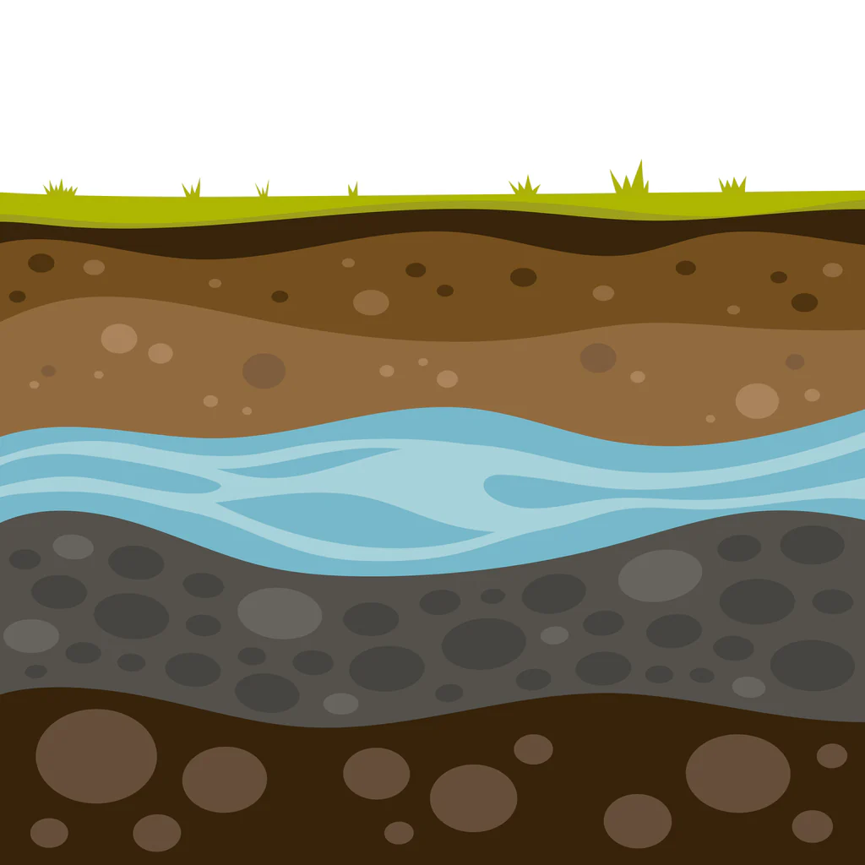
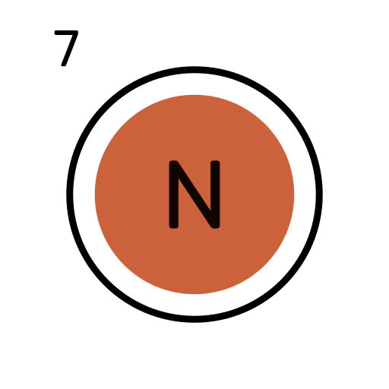
Spatial Modeling of Nitrate Leaching in the Netherlands
AI-driven Data Engineering and Reusability for Earth and Space Sciences (DARES) @ ECAI 2025
Authors: Iulia Capralova, Juan Cardenas-Cartagena.

Slide 2
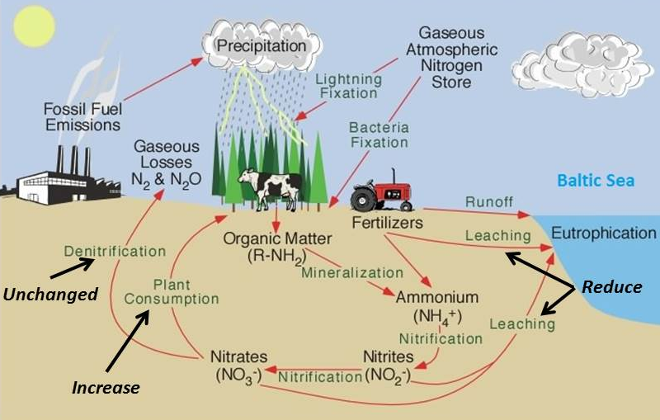
Motivation
Nitrate leaching → The process of washing nitrogen out through the soil with water.
→ Happens when the soil contains more nitrate than plants can absorb.
Source: https://ragnabodata.se/drainage_irrigation/nitrogencycle.html

Slide 3
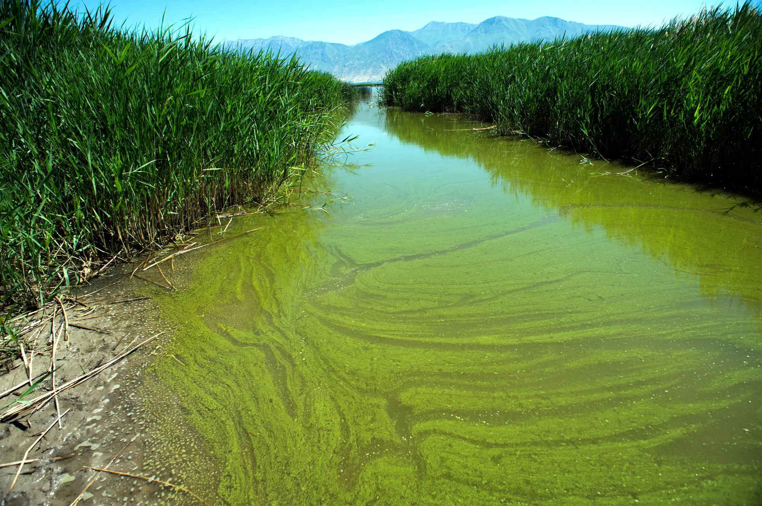
Motivation
Nitrate leaching → The process of washing nitrogen out through the soil with water.
→ Happens when the soil contains more nitrate than plants can absorb.
Why is it a problem?
Leads to groundwater pollution
Causes algal blooms and fish die-off
Risks public health (e.g., blue baby syndrome)
Algal bloom
Source:
https://nypost.com/2018/06/22/toxic-algae-blooms-becoming-more-common-across-us/

Slide 4
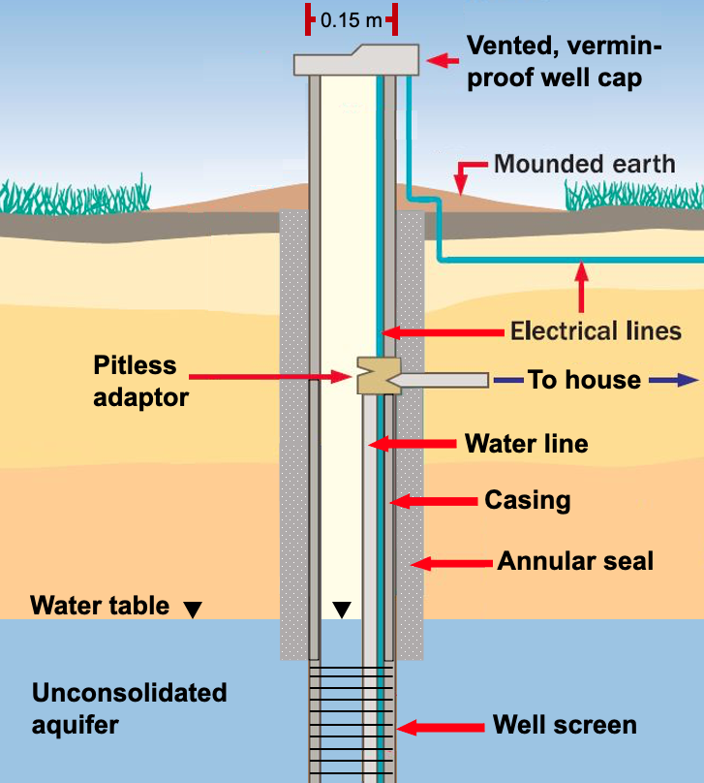
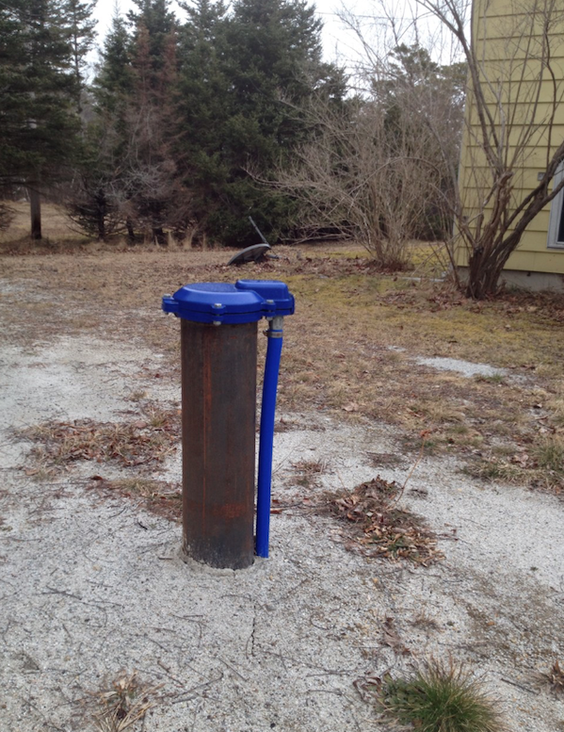
Motivation
Nitrate leaching → The process of washing nitrogen out through the soil with water.
→ Happens when the soil contains more nitrate than plants can absorb.
→ Can be monitored by sampling groundwater through monitoring wells.
Algal bloom
Source: https://books.gw-project.org/domestic-wells-introduction-and-overview/chapter/drilled-wells/

Slide 5
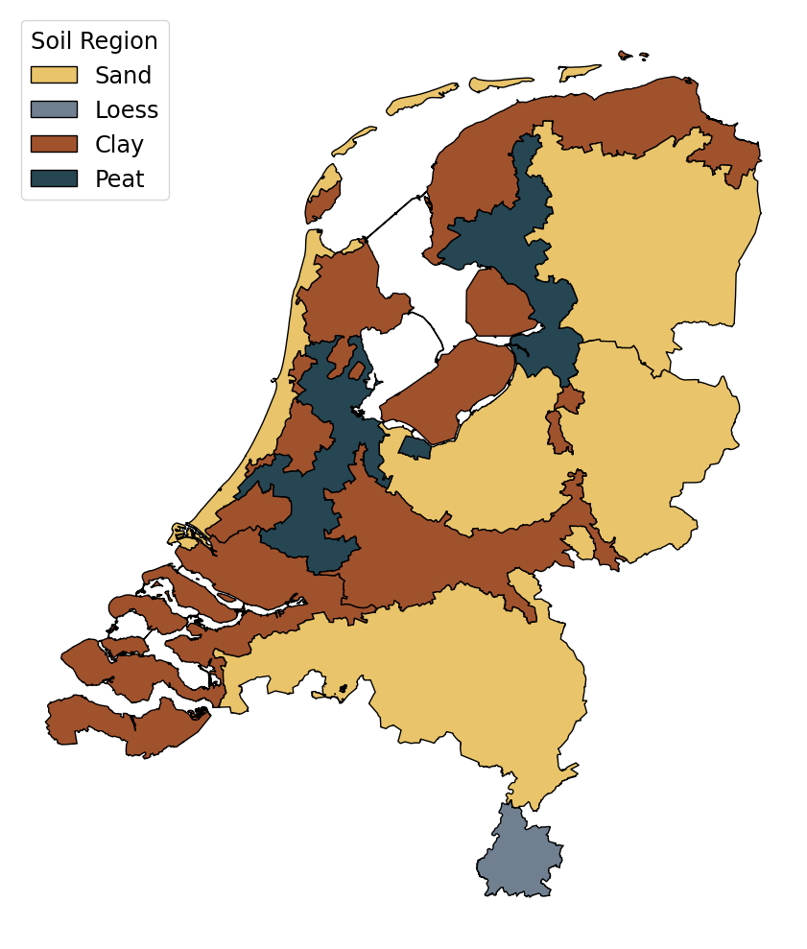
Motivation
Relevance for the Netherlands:
66% of the land area is used for agriculture [1]
Highest livestock density of EU countries [2]
High fertilizer usage [3]
Sandy soils (50% of area) provoke nitrate leaching [4, 5]

Slide 6
Motivation
Objective:
To develop an explainable spatial regression model for predicting nitrate concentrations in groundwater in the Netherlands, using spatial and environmental factors.

Slide 7
Motivation
Objective:
To develop an explainable spatial regression model for predicting nitrate concentrations in groundwater in the Netherlands, using spatial and environmental factors.
Challenges:
Monitoring wells are sparse → many areas with no direct data
Groundwater sampling is expensive → low sampling frequency

Slide 8
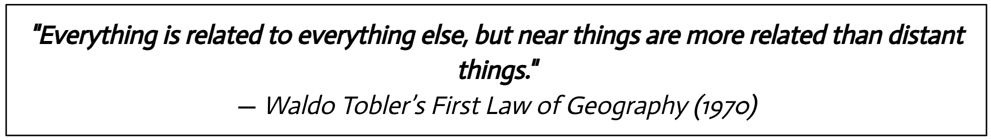
2. Literature review
Traditionally spatial and temporal autocorrelation is used.

Slide 9
2. Literature review
Relying on geographic proximity and may omit environmental interactions involved in nitrogen cycle:
Spijker et al. (2022): → Introduced environmental variables
→ Developed Random Forest model

Slide 10
2. Literature review
Relying on geographic proximity and may omit environmental interactions involved in nitrogen cycle:
Spijker et al. (2022): → Introduced environmental variables
→ Developed Random Forest model
Limitations addressed:
Limited temporal scope — only year 2017 was analyzed
Missing key nitrogen cycle factors – explained 58% of variance
Used only model-specific interpretability

Slide 11
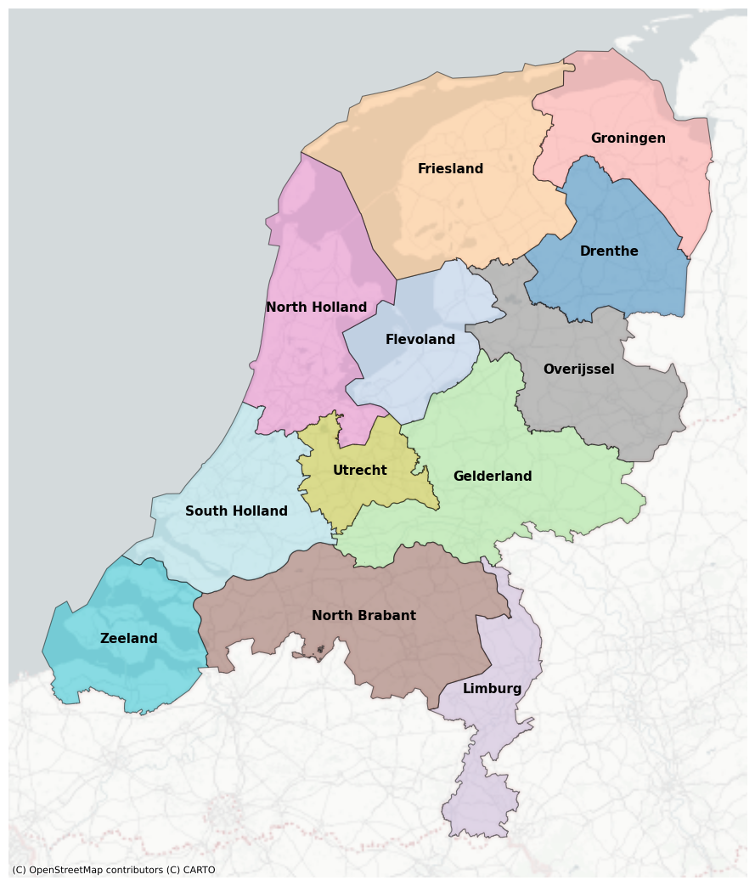
3. Methods
Study Area & Time Period
12 provinces
City regions are excluded
Years: 2008 - 2023

Slide 12
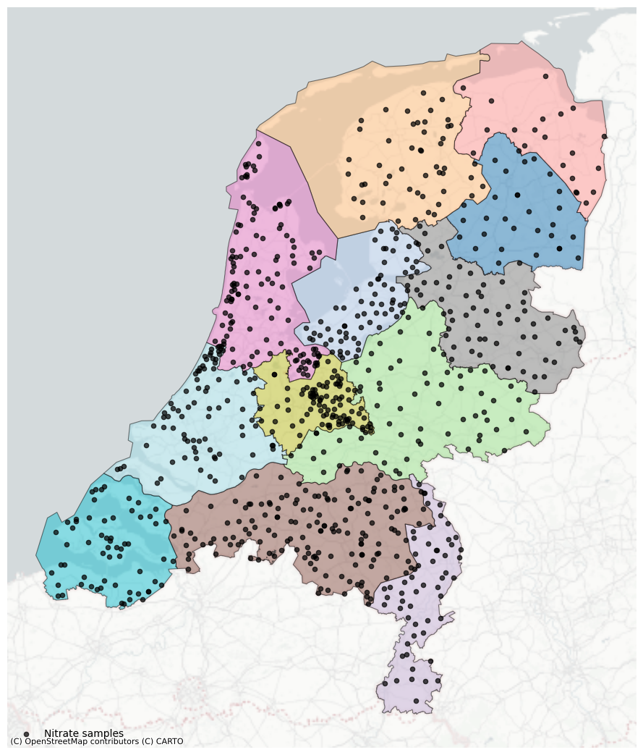

3. Methods
b) Target variable
Nitrate concentration in groundwater
~870 locations
Sampled about twice a year
Source:
Basic Subsurface Registration
(BRO)

Slide 13







3. Methods
c) Explanatory variables
Time Series
Spatial
Population density (CBS)
Temperature (KNMI)
Elevation (AHN)
Precipitation (KNMI)
Land use (WER)
Groundwater table (BRO)
Soil and geochemical properties
(BRO)

Slide 14
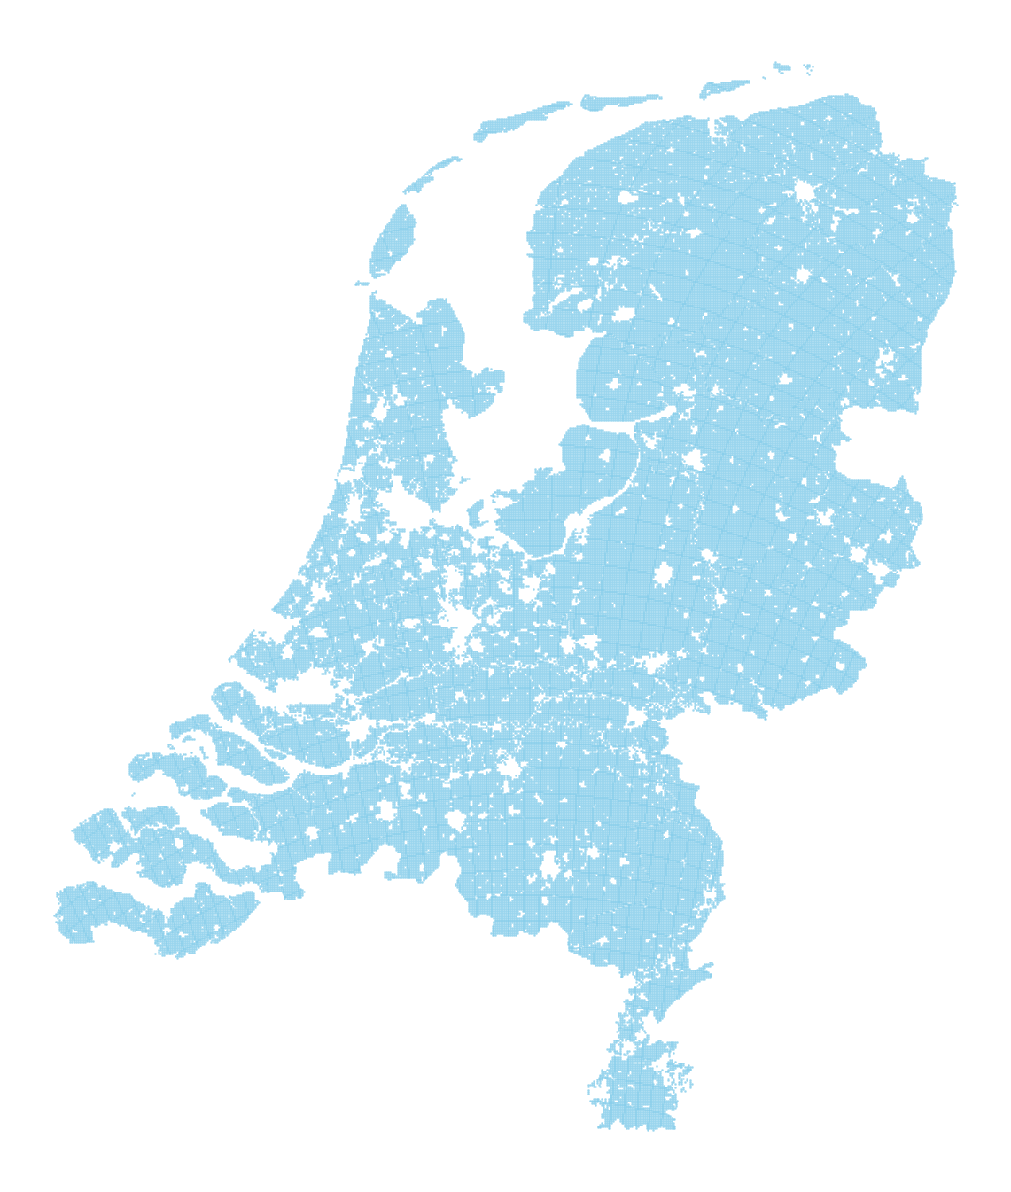
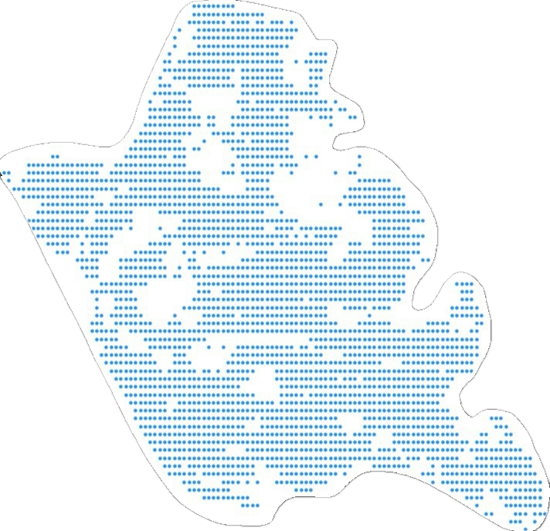
3. Methods
d) Prediction grid
Nationwide 500 × 500 m prediction map
Excluding city regions
Each point → location + date +
environmental factors
Years: 2010 | 2017 | 2021 | 2023

Slide 15




3. Methods
e) Data Pre-processing
Sources:
Cleaning
Aligning
Feature engineering

Slide 16
3. Methods
f) Model selection
Ridge Regression
Linear model with L² regularization to prevent overfitting
Interpretable by design
Random Forest
Ensemble of decision trees – non-linearity
Model-specific interpretability (Gini impurity reduction)
XGBoost (Extreme Gradient Boosting)
Sequentially adds trees to correct previous errors
Model-specific interpretability (Loss-reduction gain)

Slide 17
3. Methods
f) Model selection
Ridge Regression
Linear model with L² regularization to prevent overfitting
Interpretable by design
Random Forest
Ensemble of decision trees – non-linearity
Model-specific interpretability (Gini impurity reduction)
Model-agnostic interpretability applied across all models.
Best-performing models
combined in Ensemble prediction.
XGBoost (Extreme Gradient Boosting)
Sequentially adds trees to correct previous errors
Model-specific interpretability (Loss-reduction gain)

Slide 18
3. Methods
g) Metrics
Coefficient of Determination (R² ) → Goodness of fit
Mean Absolute Error (MAE) → Average error
Root Mean Squared Error (RMSE) → Impact of large mistakes

Slide 19
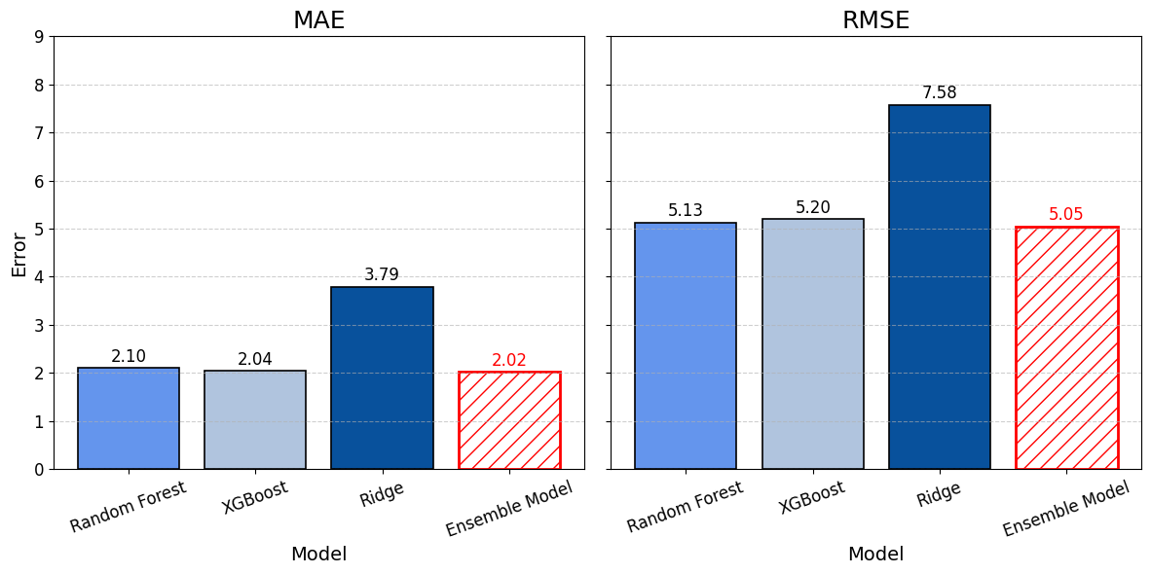
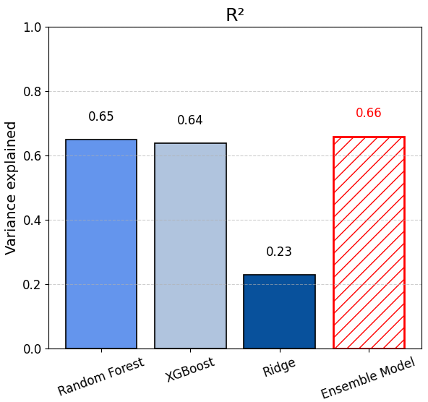
4. Results
a) Performance evaluation

Slide 20
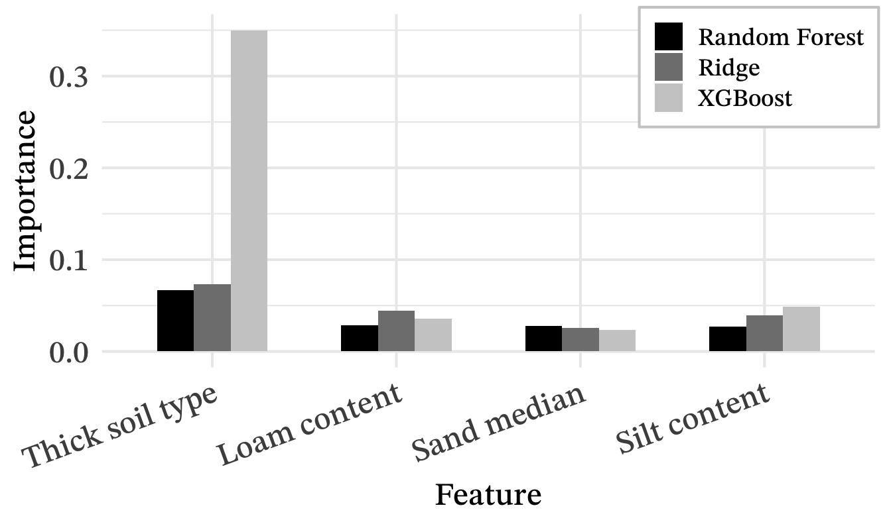
4. Results
b) Feature Importances - Model Specific

Slide 21
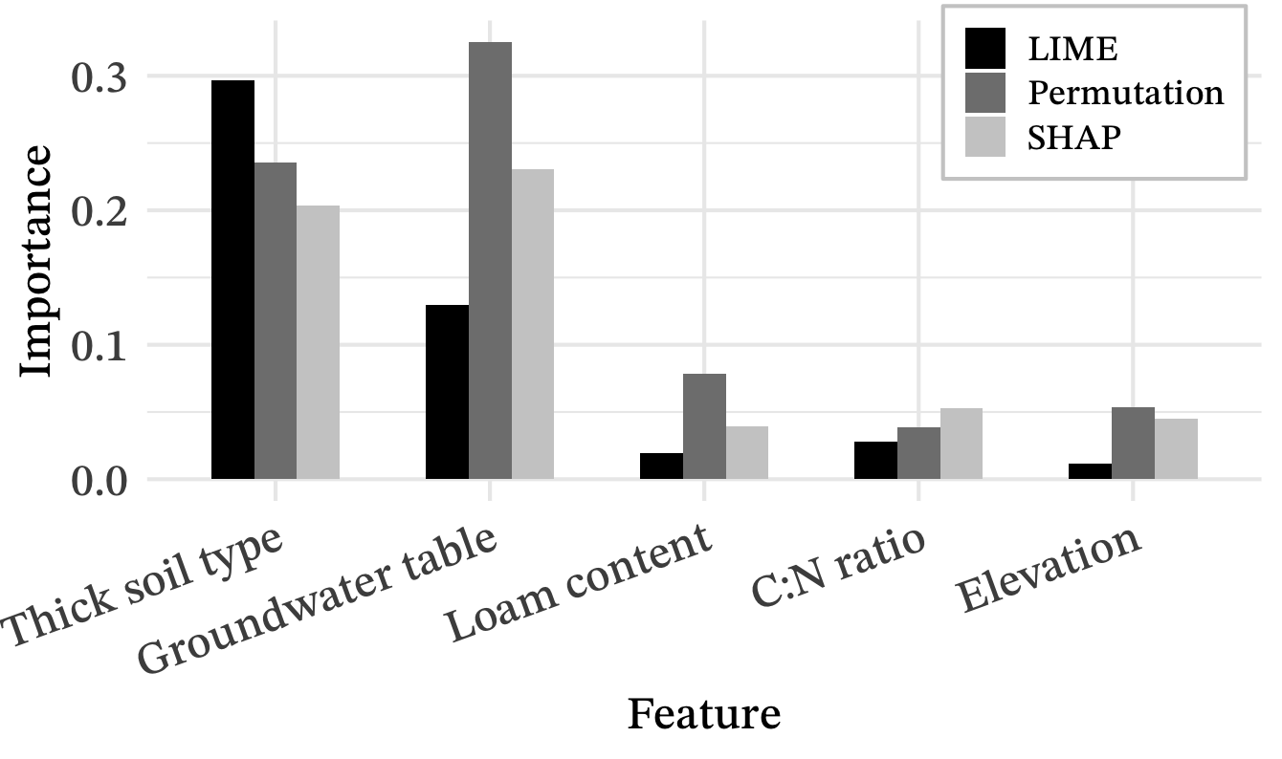
4. Results
c) Feature Importances - Model Agnostic

Slide 22
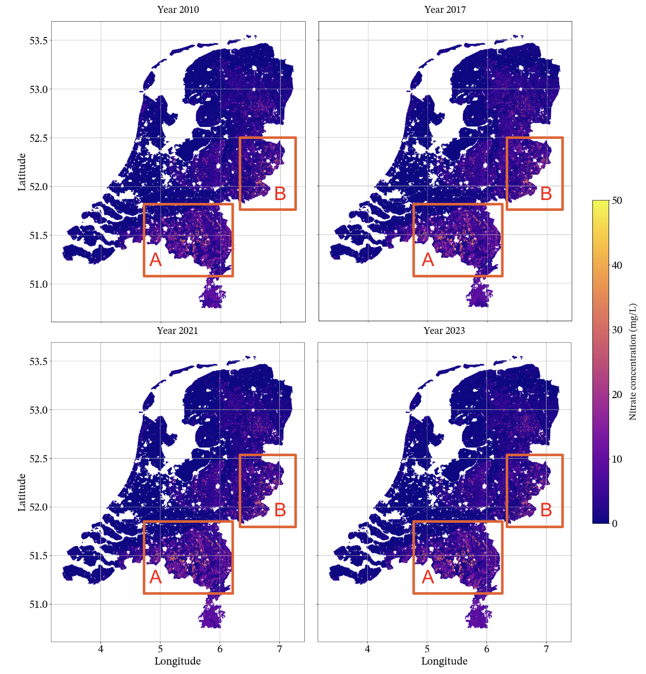
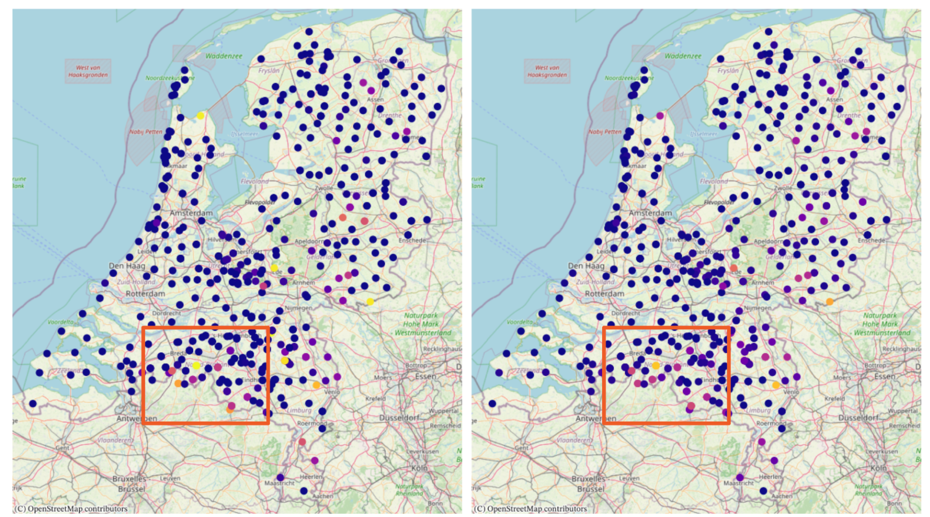
4. Results
d) Test set predictions (year 2021)
True Nitrate (year 2021)
Predicted Nitrate (year 2021)

Slide 23
4. Results
e) Grid predictions
2010
2017
2021
2023

Slide 24
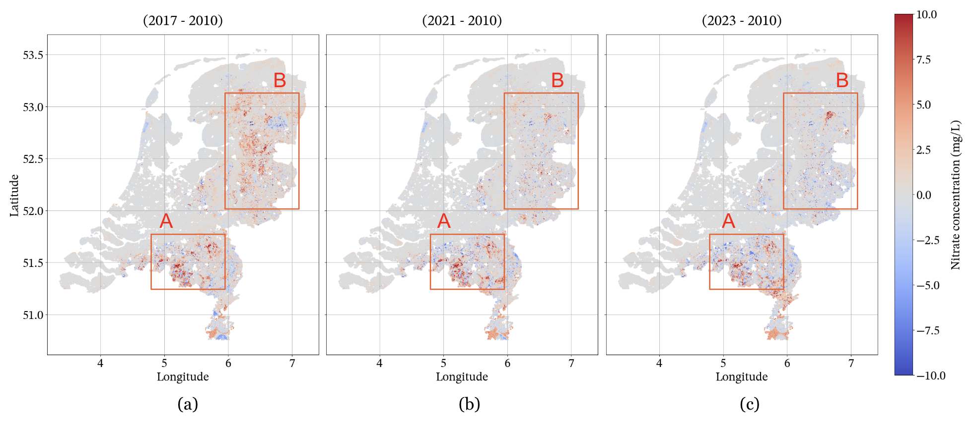
4. Results
f) Changes over years

Slide 25
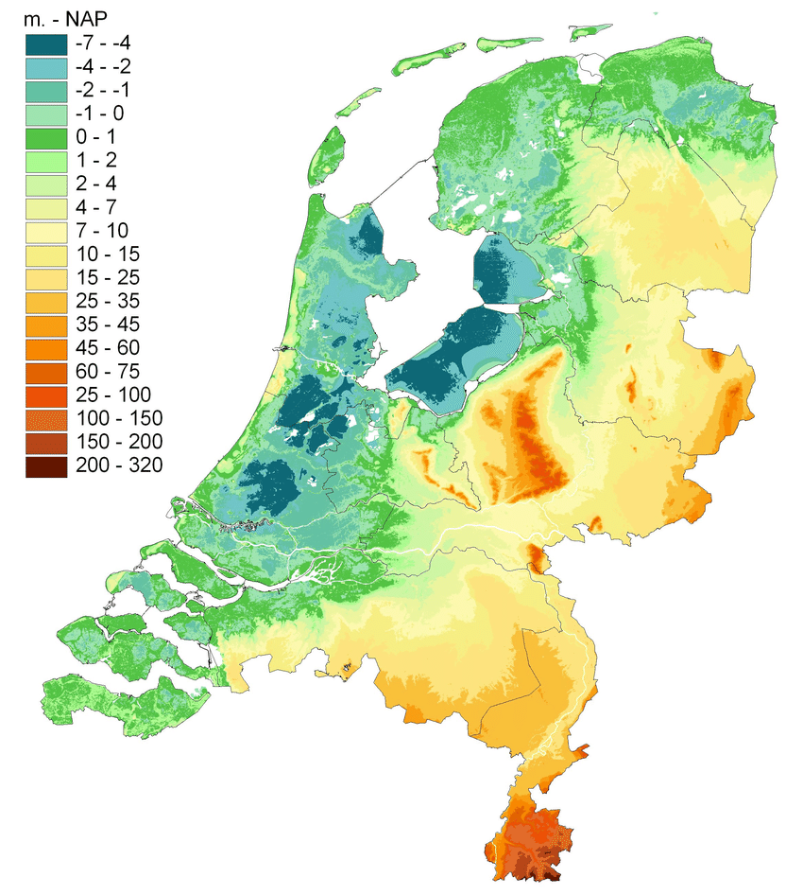
5. Discussion
a) Feature importance insights
Thick earth soils
Sandy, highly permeable
Low loam content
Low values → unbalanced soil
Deeper groundwater tables
Proxy for elevation
Elevation
Soil type

Slide 26
5. Discussion
b) Spatial trends
High nitrate areas → nitrogen surplus after year 2015 [10]
Region A: dry, sandy soils, and low share of grasslands.
Region B: more grasslands, and higher proportion of peat.
Anomaly: northern Drenthe (2023) → study limitation.
B
A

Slide 27

5. Discussion
c) Limitations
Spatial mismatch between groundwater & nitrate datasets (r ≈ 0.6).
Models underpredict nitrate values above 6 mg/L due to skewed nitrate dataset
~34 % of variance remains unexplained → Lack of fertilizer input data

Slide 28
6. Conclusion
Random Forest and XGBoost outperformed Linear Regression
Ensemble model performed best → R² = 0.66
Key predictors: thick soil types, loam content, and groundwater depth.
Highest nitrate risk: South and North-East of the Netherlands.
Future work:
Add agricultural practice, and fertilizer data → Capture finer-scale variability and improve predictions.

Slide 29
Thank you!

Slide 30
Iulia Capralova
i.capralova@student.rug.nl
Juan Cardenas-Cartagena
j.d.cardenas.cartagena@rug.nl

Slide 31
References
European Commission. (2025). CAP Strategic Plan: Netherlands. Retrieved from https://agriculture.ec.europa.eu/cap-my-country/cap-strategic-plans/netherlands_en
Eurostat. (2022). Agri-environmental indicator – livestock patterns. Retrieved from https://ec.europa.eu/eurostat/statistics-explained/index.php?title=Agri-environmental_indicator_-_livestock_patterns
Eurostat. (2024). Fertiliser consumption (aei_fm_usefert). Retrieved from https://ec.europa.eu/eurostat/databrowser/view/aei_fm_usefert/default/bar?lang=en
Delta Programme. (2024). Elevated Sandy Soils. Retrieved from https://english.deltaprogramma.nl/areas/elevated-sandy-soils
Van Drecht, G. (1993). Modelling of regional scale nitrate leaching from agricultural soils, The Netherlands. Applied geochemistry, 8, 175-178.
Verloop, J., van den Brink, C., & Gielen, J. (2025). Effectiveness of Voluntary Nutrient Management Measures to Reduce Nitrate Leaching on Dairy Farms Using Soil N Surplus as an Indicator. Water, 17 (3), 455.
D'Agostino, V., Greene, E. A., Passarella, G., & Vurro, M. (1998). Spatial and temporal study of nitrate concentration in groundwater by means of coregionalization. Environmental geology, 36(3), 285-295.
Boumans, L. J., Fraters, D., & Van Drecht, G. (2005). Nitrate leaching in agriculture to upper groundwater in the sandy regions of the Netherlands during the 1992–1995 period. Environmental Monitoring and Assessment, 102, 225-241.
Spijker, J., Fraters, D., & Vrijhoef, A. (2021). A machine learning based modelling framework to predict nitrate leaching from agricultural soils across the Netherlands. Environmental Research Communications, 3(4), 045002.
B. Fraters, A. Hooijboer, A. Vrijhoef, A. Plette, N. Van Duijnhoven, J. Rozemeijer, M. Gosseling, C. Daatselaar, J. Roskam, H. Begeman, Agricultural practices and water quality in the netherlands; status (2016-2019) and trend (1992-2019) (2021).

